Slide 1

Chapter 10
Applications of flows and cuts
Divesh Aggarwal
School of Computing
Department of Computer Science

Slide 2
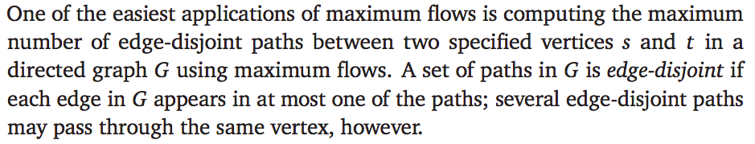
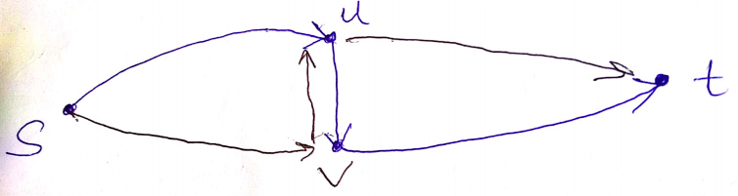
Edge disjoint paths
If we give each edge capacity 1, then max flow from s to t is the maximum number of edge disjoint paths from s to t.
What if the max-flow uses an edge that was created during max-flow execution

Slide 3
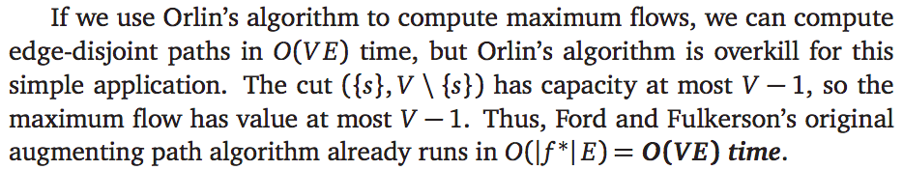
Edge disjoint paths

Slide 4
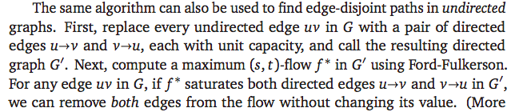
For undirected graphs

Slide 5
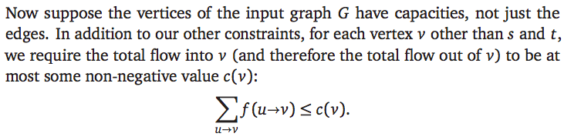
Vertex capacities

Slide 6
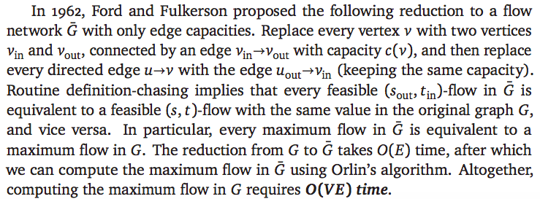
From vertex capacities to edge capacities

Slide 7

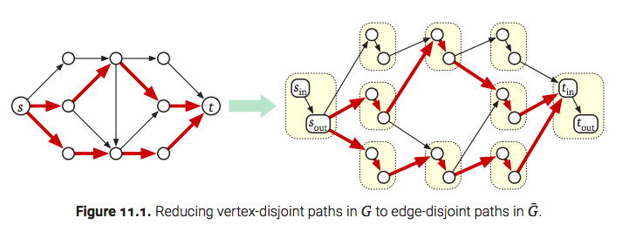
Vertex disjoint paths

Slide 8
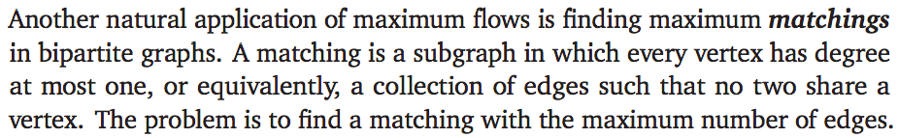
Bipartite matching

Slide 9
An application of bipartite matching
For example, suppose we have a set of doctors who are looking for jobs, and a set of hospitals who are looking for doctors.
Each doctor lists all hospitals where they are willing to work
Each hospital lists all doctors they are willing to hire.
Our task is to find the largest subset of doctor-hospital hires that everyone is willing to accept.
This problem is equivalent to finding a maximum matching in a bipartite graph
There is an edge between a doctor and a hospital if and only if each find the other acceptable.

Slide 10
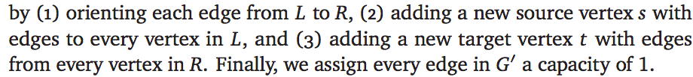
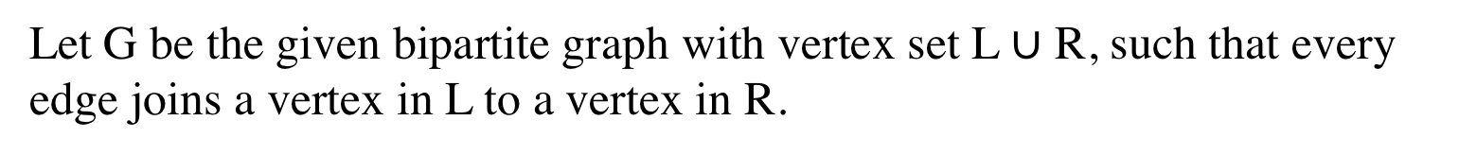
Solution via max-flow
We can solve this problem by reducing it to a maximum flow problem, as follows.
Let G be the given bipartite graph with vertex set L $∪$ R, such that every edge joins a vertex in L to a vertex in R.
We create a new directed graph G’ by:
Maximum-flow in G’ gives the maximum matching in the original graph!

Slide 11
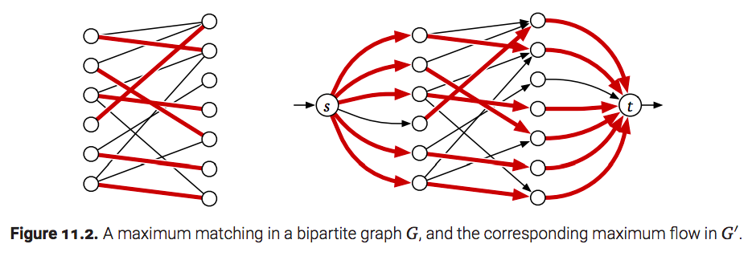
Solution via max-flow

Slide 12
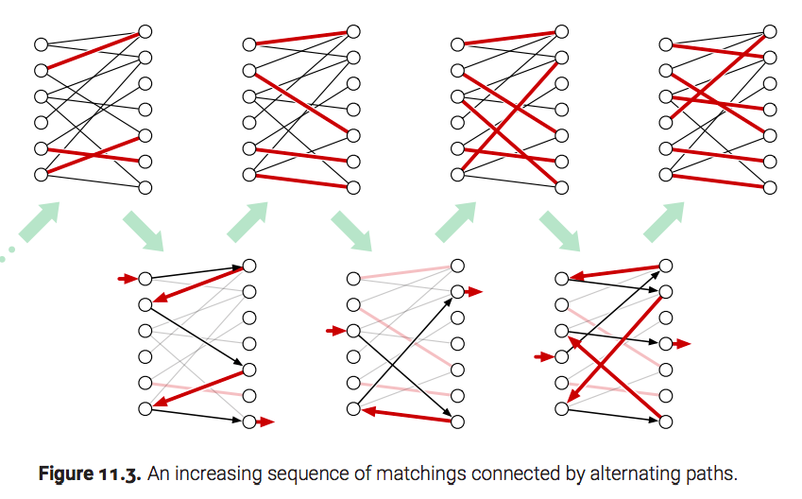
How Ford—Fulkerson works

Slide 13
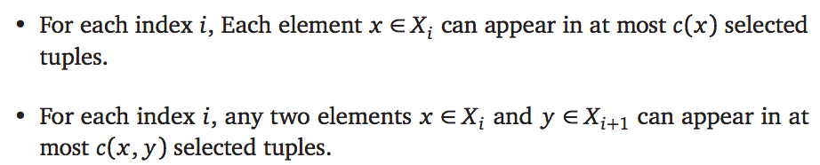
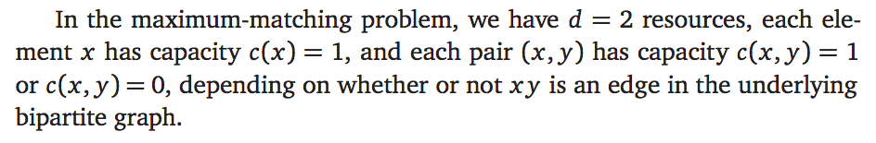
Tuple-selection

Slide 14
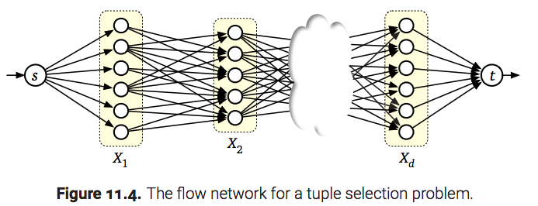
Modeling as a max-flow problem

Slide 15
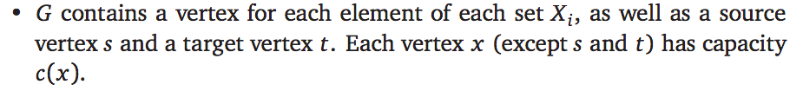
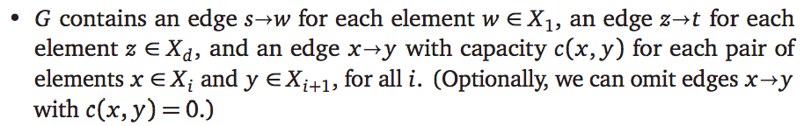
Modeling as a max-flow problem
Max-flow on the graph G gives a solution of the tuple selection problm
Disclaimer: Note that this algorithm finds the largest multiset of d-tuples, i.e., same tuple can appear more than once in the solution.

Slide 16
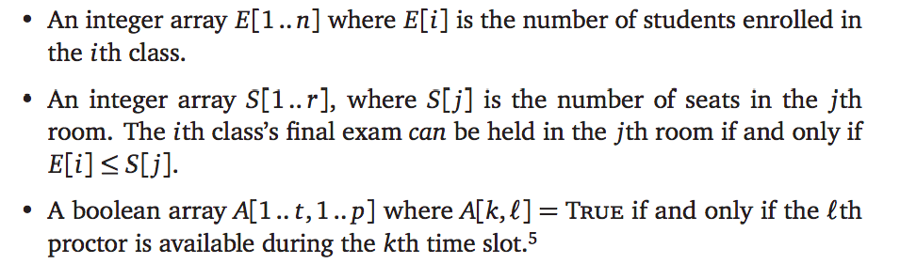
Exam scheduling
Input:
Constraints:
No proctor is allowed oversee more than 5 exams total.
Each proctor can oversee at most one exam at a time
At most one class’s final exam can be scheduled in each room during each
time slot

Slide 17
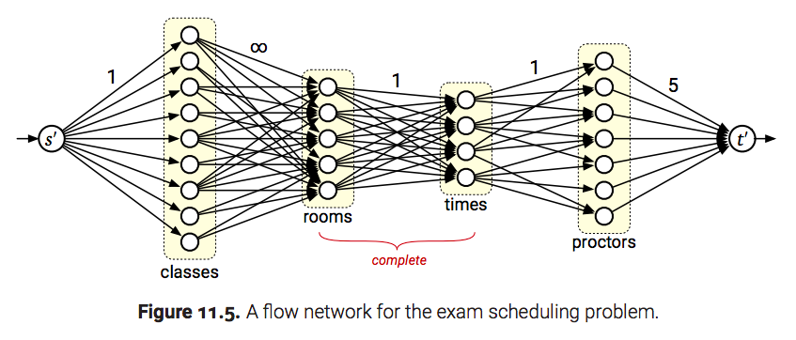
Exam scheduling
O(VE) = O(n³) time algorithm via max-flow

Slide 18
Disjoint path cover
A path cover of a directed graph G is a collection of directed paths in G such that every vertex of G lies on at least one path. A disjoint-path cover of G is a path cover such that every vertex of G lies on exactly one path.
This problem is hard in general. We will see an algorithm based on directed acyclic graphs.

Slide 19
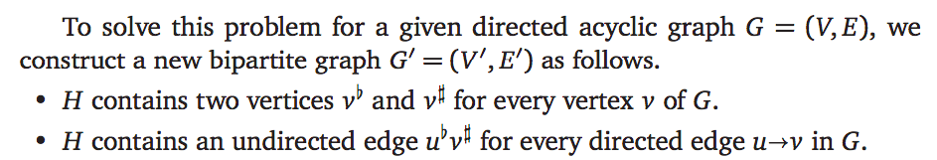
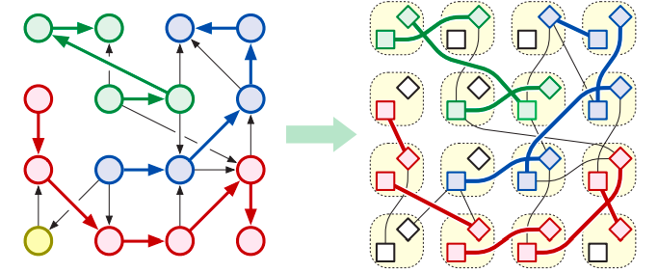
Disjoint path cover

Slide 20
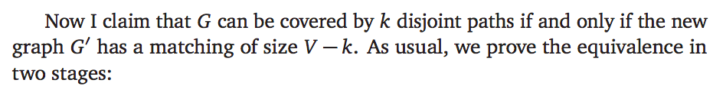
Disjoint path cover

Slide 21
Disjoint path cover
Claim: G can be covered by k disjoint paths if and only if G’ has a matching of size V – k.
Proof by picture ☺

Slide 22
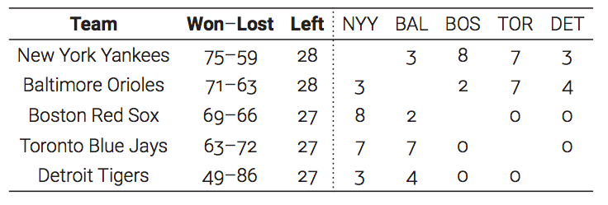
Baseball Elimination
Often, it is easy to spot when a team is eliminated—they can’t win enough games to catch up to the current leader in their division.
Detroit can reach 76 if they win all their remaining games. So, can they end up being the leader?

Slide 23
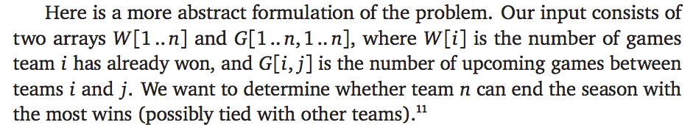
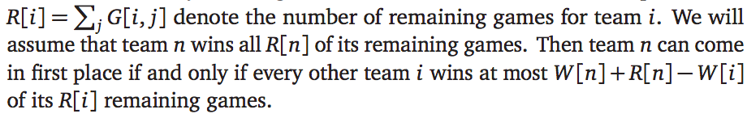
Modeling as a flow problem

Slide 24
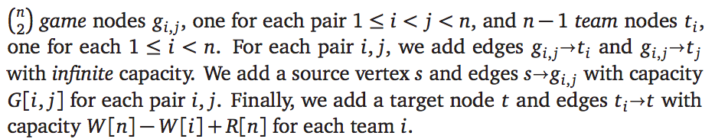
Modeling as a flow problem

Slide 25
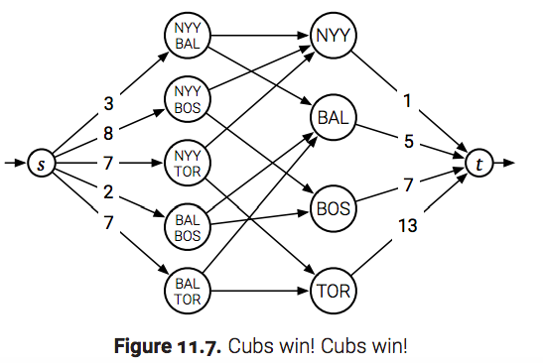
Modeling as a flow problem

Slide 26
Modeling as a flow problem

Slide 27
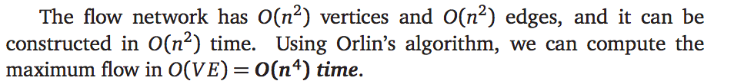
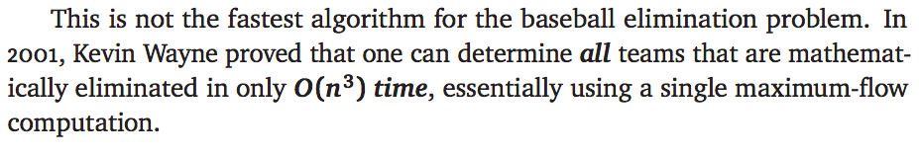
Time complexity

